Slide 1
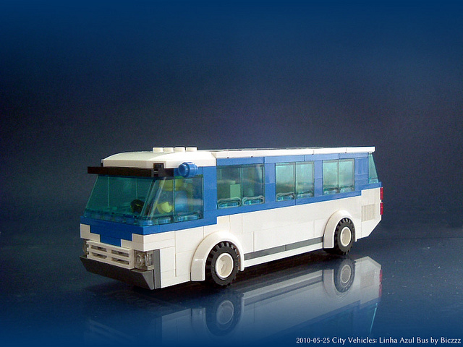
Transit Appliances
Disruptively Low-cost
Transit Displays

Slide 2
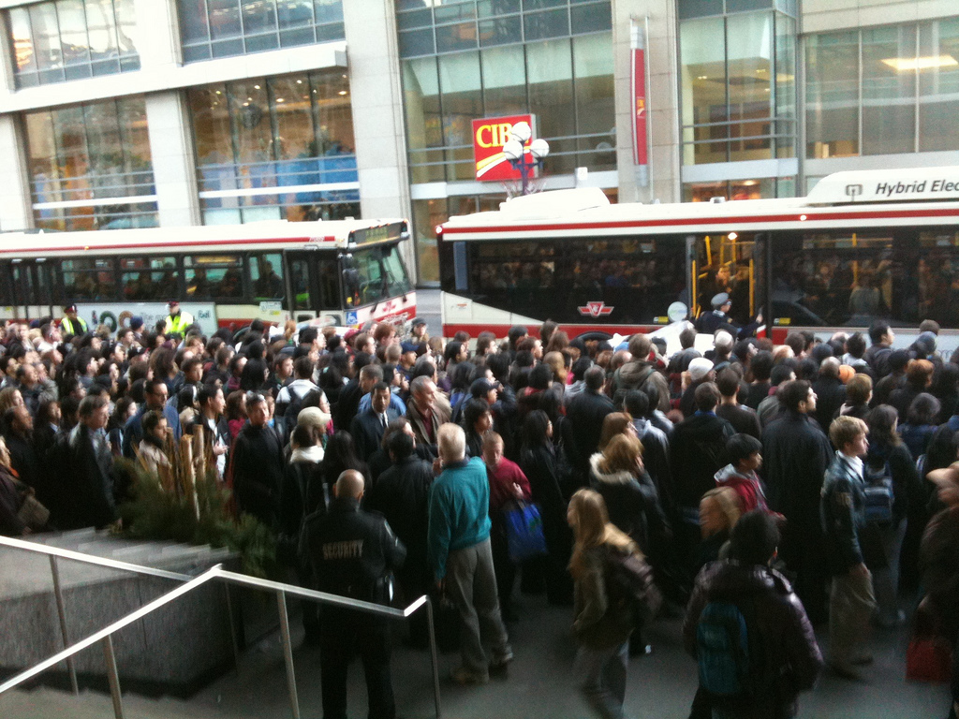
The Mission: Display it and They Will Ride!
Sweetsop’s Flickr Photostream
Notes:
Sweetsop’s Flickr Photostream

Slide 3
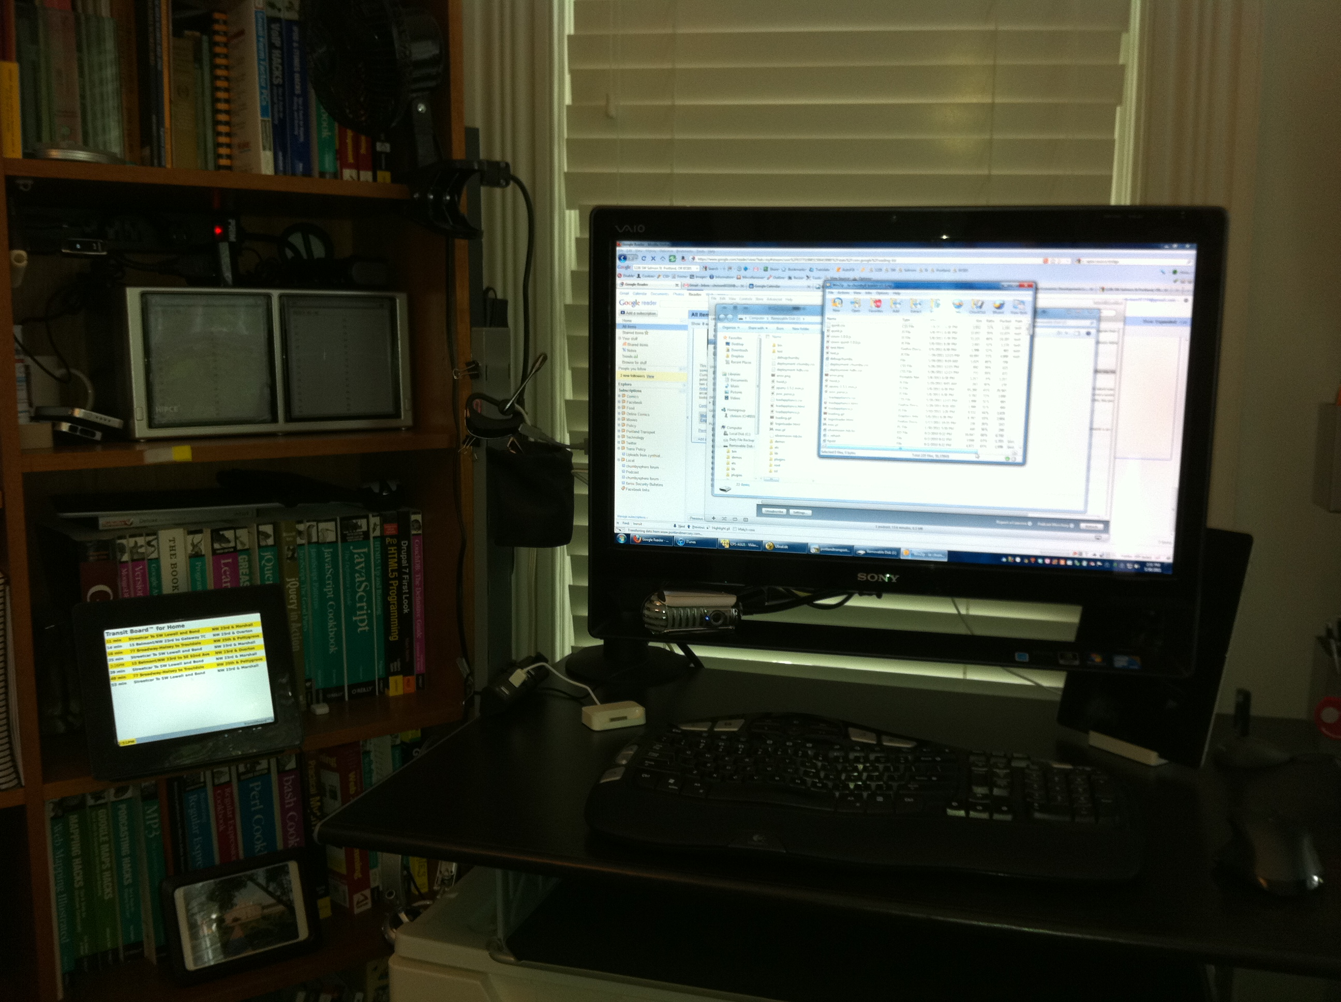
Scratching My Own Itch

Slide 4
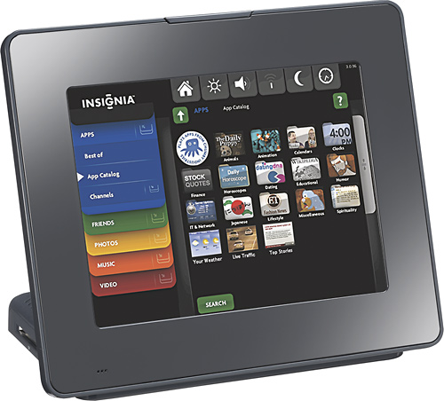
The Inspiration
Insignia Infocast
(Chumby 8)
~ $199

Slide 5
Key Concepts for Today
Building a JavaScript Kiosk
The Appliance Model
“Phone Home” Configuration Approach
One arrivals API to rule them all
Aiming for Disruptively Inexpensive
Creating an Ecosystem for Success

Slide 6
JavaScript Kiosk
JavaScript Loader
Qt Web Viewer
Chumby Platform
Debugchumby script

Slide 7
Why JavaScript?
Preference for JSON for Web Services
  Opportunity for cross-domain transport with JSONP
  Versatile while understandable data structures
Opportunity to share code modules between client and server
Save server costs by putting as much processing in the client as possible

Slide 8
Some of the
Technologies Employed
Google App Engine with JSONEngine package
CouchDB (Iris Couch and Cloudant)
Node.js
jQuery and jQueryUI
YQL as JSONP proxy

Slide 9
Another JavaScript Kiosk
JavaScript Loader
Webconverger Kiosk
Debian Live

Slide 10
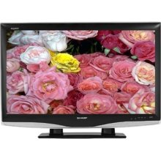
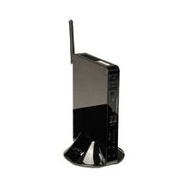
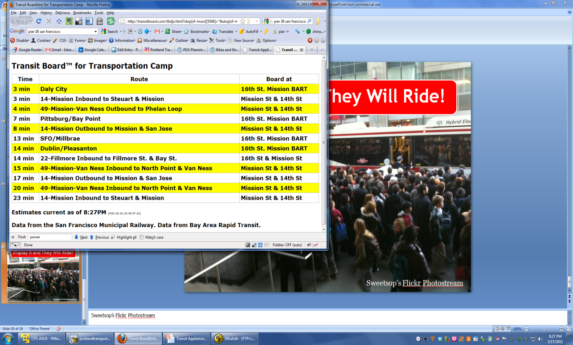
Commodity Client Hardware
46” HDTV
Barebones Atom PC
+
~ $600
~ $200

Slide 11
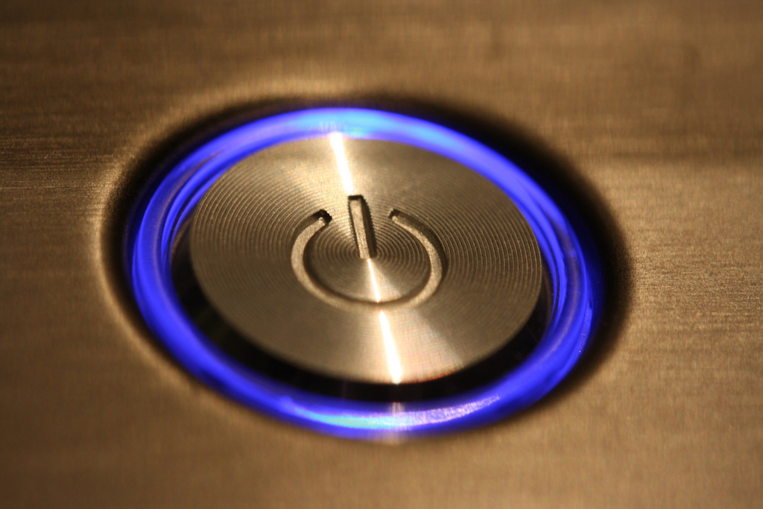
The Appliance Model
sparkieblues’s Flickr Photostream

Slide 12

On-Site Admin
Boris Van Hoytema’s Flickr Photostream

Slide 13
“Phone Home” Pattern
Keep all config info in the cloud
Each appliance has a unique id (using MAC so far)
Redundant config stores
      MAC -> display application URL
  Additional security through separate (and redundant) validation service to confirm returned URL is a valid display application

Slide 14
An Arrival is an Arrival is an Arrival…
{
"arrivalTime": "1299960275000",
"type": "scheduled",
"headsign": "77 Broadway-Halsey to Troutdale",
"stop_id": "7219",
"stop_data": {GTFS stop data},
"route_id": "77",
"route_data": {GTFS route data},
"agency": "TriMet",
"last_updated": "1299959306921"
}

Slide 15
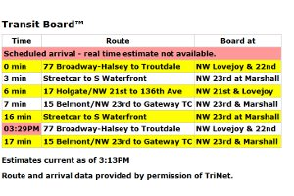
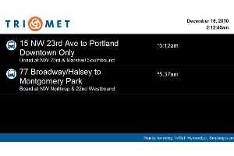
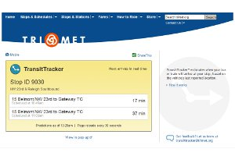
One API, Many UIs

Slide 16
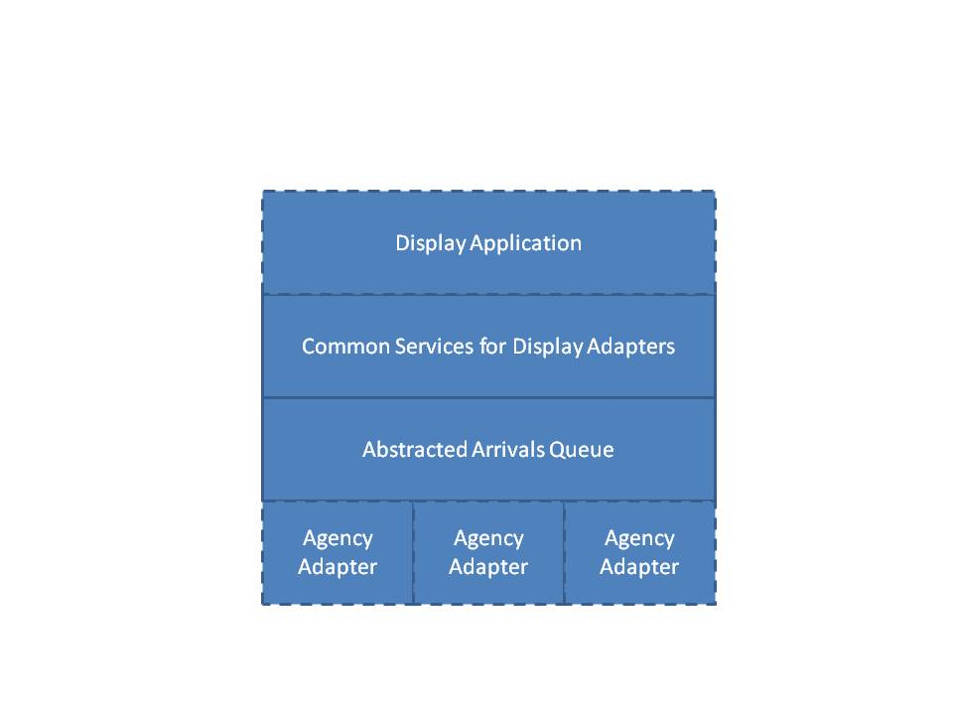
Architecture for JS-based Arrival Displays

Slide 17
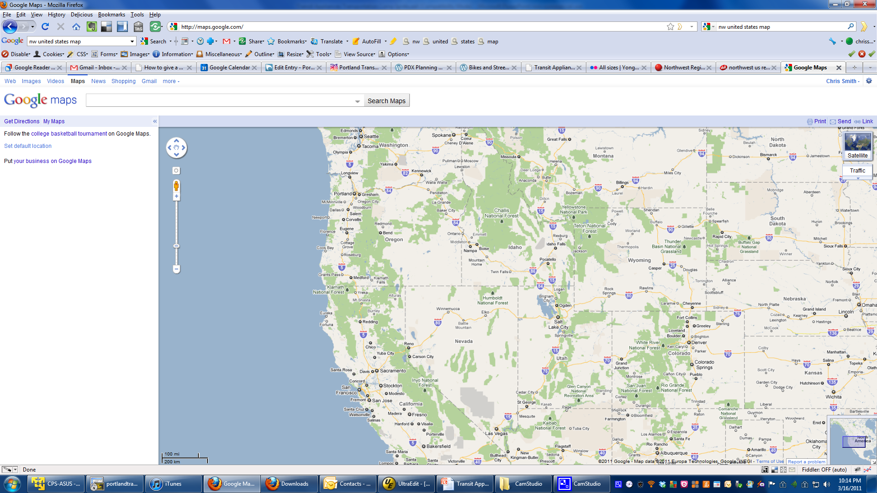
TriMet
Portland Streetcar
MUNI
BART
AC Transit

Slide 18
Disruptively Inexpensive
Commodity Hardware for clients
Other People’s Servers
  Minimize configuration interaction
Leverge Communications Already in Place
Stay Below Fremium Limits

Slide 19
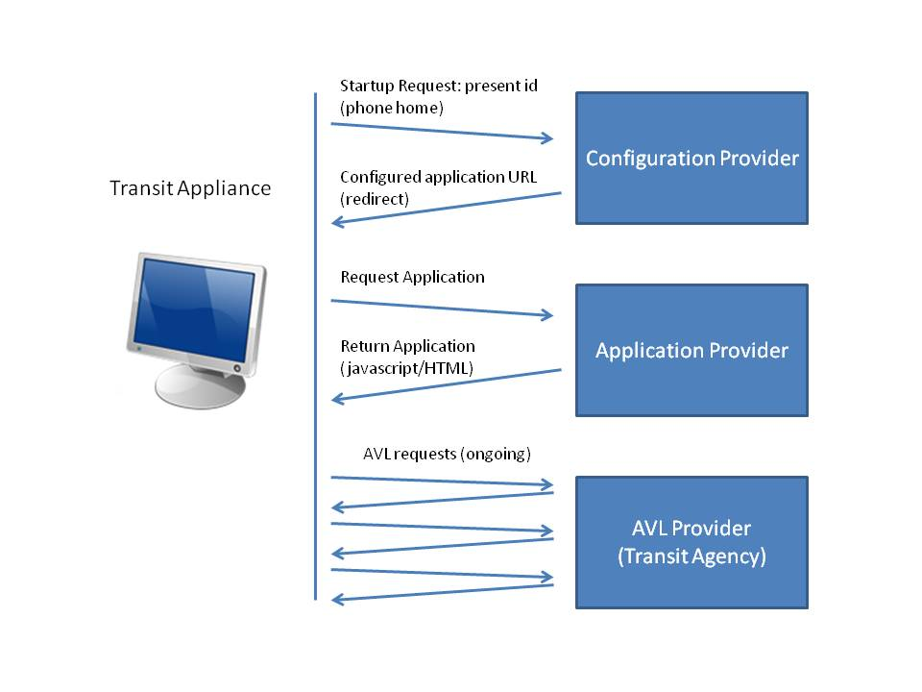
Other People’s Servers
Target Operating Cost: $0
Initialization (20 sec):
Google App Engine
CouchDB
Operation (days):
Agency AVL Servers

Slide 20
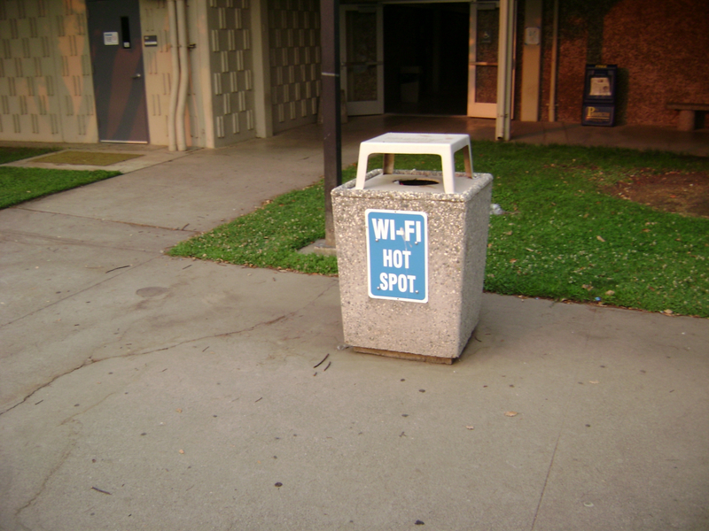
Leverage Existing Networks
Yuba College Public Space Flickr Photostream

Slide 21

Appliance Project Ecosystem
AVL Web Services
GTFS Data
UI Providers
Configuration Service
Display Client Platforms
Hardware Installers
CIAT International Center for Tropical Agriculture

Slide 22
Open Source!
            Apache 2.0 Licensed:
                Chumby/Infocast ‘appliance loader’
                Arrivals Javascript API
                Configuration Tool

Slide 23
Acknowledgements
          Team Members
            Chris Smith, Architect, lead developer
            Matt Conway (SF), ‘phone home’ loader
            Francis Storr, UX for Config Tool
            Scott Garman, Linux distro builder
          Portland Transport
            Oregon 501(c)(3) with focus on promoting discussion around transportation policies and facilitating tools for transportation information display
            Home for all project intellectual property
            Offering Transit BoardTM Since 2006

Slide 24
More Info
Project Blog
  http://transitappliance.org
Code Repositories
  http://code.google.com/p/transit-appliance-config/
  http://code.google.com/p/transit-appliance-loader/
Configuration Service
  http://service.config.transitappliance.com/
chris@chrissmith.us

